Slide 1
DynamoDB Manager
2020/05/06

Slide 2
DynamoDB Manager
DB Overview
Manage Tables
Manage Table Items
DB Name: My Test DB
Table Number: 5
Size: 1GB

Slide 3
DynamoDB Manager
DB Overview
Manage Tables
Manage Table Items
Create a table
Delete tables

Slide 4
DynamoDB Manager
DB Overview
Manage Tables
Manage Table Items
Choose a table…

Slide 5

Manage Table Items
Table Name
tableName
Choose a table…
Update Items
Add Item
Add Attribute
Delete
Filter
Name | attr1 | attr2 | attr3
Type | string | number | binary
Key Type | HASH | RANGE | NON-KEY
 | A1 A11 | A2 | A3
Add
attr3 | attr4
C0
 | D0
(Update…) Modify
Delete
Modify
Reverse Change
Update
items:
[
{id: 0, updateMethod: delete, attrs: {attr1: A0, attr2: B0}},
{id: 1, updateMethod: modify, attrs: {attr1: A1, attr2: B1}},
{id: 2, updateMethod: add, attrs: {attr1: A2, attr2: B2}},
{id: 3, updateMethod: (empty), attrs: {attr1: A2, attr2: B2}},
]

Slide 6
Add Attribute
Add Attribute
Name:
Type:
Cancel
OK

Slide 7
Filter Items
(default)
=
A3
A0 A1 A2 A3
Filter…
 | Select All
V | A0
 | A1
V | A2
attr1 (string)
= != < > <= >=
<
A3
and or
and
>
A0
Add Condition
Clear All Conditions
Confirm
Cancel
(只允許2個條件)
attr1 (hash key)
A0
A1 A11
A2
A3
filterConditions:
[
attr1:
[{id: 0, logic: and, operator: <, value: A3},
{id: 1, logic: and, operator : >, value: A0},
{id: 2, logic: or, operator : >, value: A0}],
attr2:
[{id: 0, logic: and, operator: <, value: B3},
{id: 1, logic: and, operator : >, value: B0}]
]

Slide 8
Create a table
* Table Name:
Attribute Definitions
(dropdown)
Add
Delete All
X
String
Enter attribute name…
X
Boolean
Enter attribute name…
Key Schema
* Hash key:
Choose an attribute…
* Range key:
Choose an attribute…
Provisioned Throughput
* Read Capacity Units:
5
* Write Capacity Units:
5
Clear All Fields
Create
Notes:
effect: https://www.w3schools.com/howto/howto_css_login_form.asp

Slide 9
Delete
 | Table A
 | Table B
 | Table C
Refresh
Deselect All
Select All
Delete
Notes:
effect: https://www.w3schools.com/howto/howto_css_login_form.asp

Slide 10
確認訊息 (覆蓋整版)
Confirmation
Action Result
Are you sure you want to XXX?
Success
OK
Cancel
Confirm
Error
X
There’s something wrong!

Slide 11
Backup

Slide 12
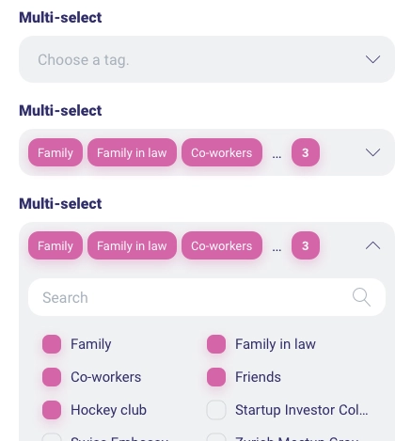

Slide 13
Create
Read
Update
Delete

Slide 14
Add table records
X
Add Records
+
*
attr1:
Enter data value
*
attr2:
Enter data value
attr3:
Enter data value
*
attr1:
Enter data value
*
attr2:
Enter data value
attr3:
Enter data value
Cancel
Confirm

Slide 15




Manage Table Items
Query Results
Total: 3 items
 | attr1 (key) | attr2 (not key) | attr3 (not key)
 | A0 | B0 | C0
 | A1 | B1 | C1
 | A2 | B2 | C2
 | A3 | B3 | C3
新增的item用綠背
Delete All
Reset All
Cancel
Update
點下使後面方位可編輯
點下使所有X被點並顯示被點
點下使所有修改還原

Slide 16
一進到此畫面就先把此table的前100筆data都列出來
Manage Table Items
Table Name
(toggle to expand / withdraw)
Choose a table…
Query Conditions
Choose an attribute…
X
Attribute X:
…
Enter a number
X
Attribute Y:
…
Enter a string
Attribute Z:
…
(true / false dropdown)
X
Choose…
(operator dropdown)
Clear all conditions
Query
Query Results
(見下頁)
Notes:
Operator dropdown:
Number:
<
>
<=
>=
=
!=
between
String:
<
>
<=
>=
=
!=
Boolean: (NA)

Slide 17
Added Items
Add Items
 | attr1 (hash key) | attr2 (range key) | attr3 | attr4
 | A0 | B0 | C0
 | A1 | B1 |  | D0
addedItems:
[
{id: 0, attrs: {attr1: A0, attr2: B0, attr3: C0}},
{id: 1, attrs: {attr1: A1, attr2: B1, attr4: D0}}
]
<input
type=“text” name={attrName} value={this.state.addedItems[attrName]} onChange={this.handleChangeAddedItems}
/>
<button onClick={() => this.handleDeleteAddedItem(id)}
/><button>
<button onClick={() => this.handleDeleteAddedAttr(id)}
/><button>
addedAttrs:
[
{id: 0, name: “attr3”},
{id: 1, name: “attr4”}
]

Slide 18
Manage Table Items
Table Name
tableName
Add
Delete
Modify
Choose a table…
(見後頁)
Udate Items
Add Item
Add Attribute
Reset | Update | attr1 (hash key) | attr2 (range key)
 | Delete | A0 | B0
 | Modify | A1 A11 | B1 B11
 | Add | A2 | B2
 |  | A3 | B3
attr3 | attr4
C0
 | D0
Total: 4 records
Update
items:
[
{id: 0, updateMethod: delete, attrs: {attr1: A0, attr2: B0}},
{id: 1, updateMethod: modify, attrs: {attr1: A1, attr2: B1}},
{id: 2, updateMethod: add, attrs: {attr1: A2, attr2: B2}},
{id: 3, updateMethod: (empty), attrs: {attr1: A2, attr2: B2}},
]

